Slide 1

Spring Website to Sell Food Items
RNS INSTITUTE OF TECHNOLOGY
BENGALURU - 98
DEPARTMENT OF INFORMATION SCIENCE & ENGINEERING
Presentation on Internship
Keerthana B 1RN22IS405
EduBridge Learning Pvt.Ltd
Internal Guide
Harshitha P
Assist. Prof., Dept of ISE, RNSIT
External Guide
Mr. Yogesh
Trainer, EduBridge

Slide 2
AGENDA
Abstract
About the Company
Introduction
Literature Survey
Requirements
System Design
Detailed Design
Implementation
Result And Discussions
Conclusion and Future Enhancements
References
Q & A

Slide 3
ABSTRACT
The Spring Website to Sell Food Items is a full-stack web application built to digitize and streamline the online food ordering process.
It facilitates smooth operations between customers, platform administrators through features like food item browsing, order placement, and inventory management.
Developed using Spring Boot for the backend and Angular 8 for the frontend, the application uses JPA for seamless interaction with a MySQL database.
The system adopts the Model-View-Controller (MVC) architecture, supporting modularity, scalability, and maintainability. It includes role-based access for customers and admins each with custom dashboards and privileges.
The project not only offers a user-friendly and responsive platform for food ordering but also serves as a solid example of modern full-stack development

Slide 4
About the Company
EduBridge Learning is a workforce development organization in India focused on bridging the gap between skill requirements and the unemployed youth.
Founded in 2009 by Indian Institute of Management (IIM) alumni and professors, EduBridge provides training and placement services to help individuals build their careers with leading companies.
They offer a range of vocational programs and career development initiatives, including mobilization, counseling, training, assessment, and placement support.
EduBridge collaborates with businesses and leading educational institutions to ensure training programs are relevant and effective.
Trained 300,000+ youth across India in key sectors like BFSI, IT/ITES, Retail, Hospitality, Logistics, and Healthcare.
Aims to create a job-ready, productive workforce that contributes to business success from day one . Partners with corporates to deliver customized training & recruitment solutions and impactful CSR programs.

Slide 5
INTRODUCTION
The Spring E-Commerce Website to Sell Food Items is a comprehensive web-based application developed to process of online food ordering and delivery.
It aims to provide a seamless interface for customers to browse food items, place orders. while also enabling merchants and administrators to efficiently manage food listings, inventory, and order processing
This system allows users to register, log in, explore restaurant menus, add items to the cart, and complete transactions—all through a responsive and intuitive user interface built with Angular.
By integrating customer, merchant, and admin functionalities into a single platform, the system enhances coordination, improves user satisfaction, and lays a robust foundation for future enhancements such as payment gateway integration, real-time delivery tracking, and mobile application support..

Slide 6
LITERATURE SURVEY
Paper Title | Authors | Year | Methodology | Advantages | Disadvantages | Summary
Optimized Web-Based Online Food Ordering System | Sunny Kalu Egereonu | 2024 | Web-based food ordering using WAMP stack. Simplifies restaurant operations with automated ordering. | Cost-effective, user-friendly for small to medium restaurants.​ | Limited scalability, basic security. | A practical system for small eateries to digitize their ordering process.
Design and Implementation of Online Food Ordering System Using Spring Cloud | Yu Yang. | 2022 | Uses Spring Cloud and Vue.js. Microservices architecture with services for menu, account, orders, etc. | Scalability, independent module development, load balancing. | Complex deployment, data consistency challenges. | Effective for high-demand systems; modular and scalable.

Slide 7
Paper Title | Authors | Year | Methodology | Advantages | Disadvantages | Summary
A Novel Spatial-Temporal Model for CTR Prediction | Jun Li et al. | 2023 | Models long-term user behavior for food delivery platforms using attention mechanisms. | High accuracy in click-through rate prediction. | Complex and resource-intensive, risk of overfitting.​ | Improves recommendation quality in food ordering platforms.
Bottom-up Adaptive Spatiotemporal Model | Boya Du et al | 2022 | Uses adaptive embeddings to capture spatiotemporal user preferences. | Better personalization, handles diverse user behavior | Higher training complexity, large data requirements. | Efficient in modeling diverse user contexts in food delivery..

Slide 8
Requirements
Hard Ware Requirements:
Processor: intel Core i5/i7 Processor speed: 2.5 Ghz quad-core or higher RAM: 8 GB Storage Space:256 GB HDD OR SSD
Software Requirements:
Operating System : Windows 10/11
Tools:
Frontend : Angular 8, Type script, HTML5, CSS3
Backend : Java 17, Spring boot
Database : MySQL
Other Development Tools:
Maven(connector)
IntelliJ IDEA/VS Code(java support)
Postman(API Testing)
Git and Github (for version control)

Slide 9
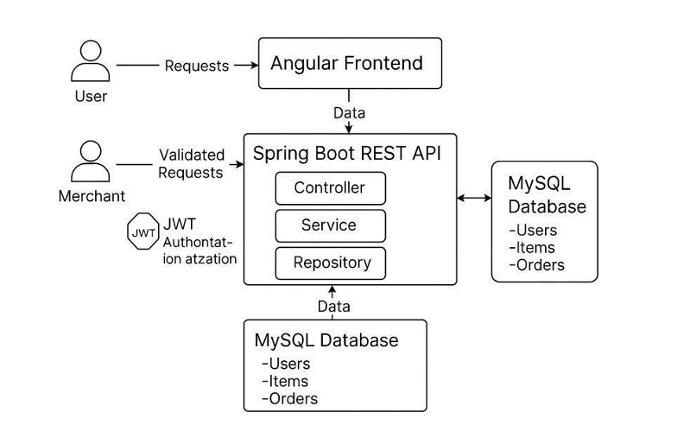
System Design
SPRING E-COMMERCE WEBSIE TO SELL FOOD ITEMS

Slide 10
System Design (cont’d)
Start
User and Merchant: User: A customer who browses food items, adds them to the cart, and places orders.
Merchant: A restaurant/vendor who manages food items (add, edit, delete).
Angular Frontend:
Built using Angular, this is the client-side interface that users and merchants interact with.
Sends HTTP requests (login, register, browse items, place orders) to the backend.
Spring Boot REST API: This is the backend server, built using Spring Boot, that handles business logic and API requests
JWT Authentication: JWT (JSON Web Token) is used for secure login.
After login, the user or merchant gets a JWT token.
MySQL Database
Th application uses MySQL as the relational database. It stores
Users: Credentials, roles, and profiles.
Items: Food menu items, availability, and prices.
Orders: Placed orders, quantities, timestamps, etc.

Slide 11
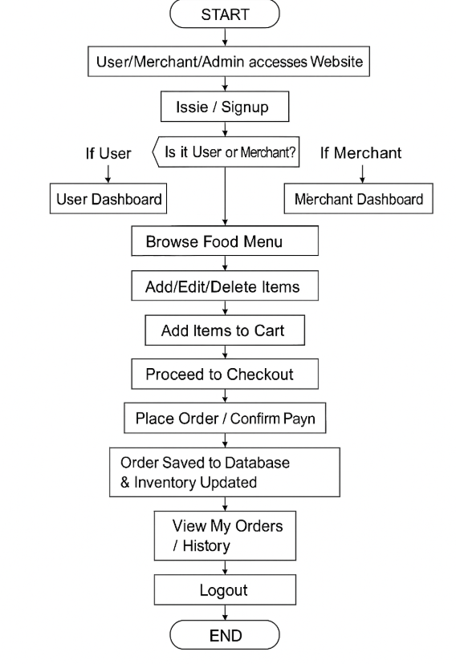
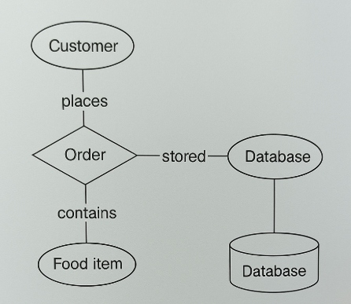
Detailed Design
ER Diagram and Work Flow Diagram

Slide 12
Detailed Design (cont’d)
Workflow Overview : The flowchart outlines the entire user journey from website access to logout. Based on role selection (User/Admin), users can browse food items and place orders, while admins manage food item listings. Orders are saved to the database, with optional payment, followed by order history access.
Role-Based Flow:
Users: Login → Dashboard → Browse Food Items → Place Orders → View Order History Admins: Login → Admin Dashboard → Add/Edit/Delete Food Items
Data Handling & Storage: Each user action (ordering, food item updates, payments) is stored in the database using backend APIs, ensuring real-time updates and data integrity.
User Experience Flow: The process is designed to be intuitive, guiding users through food item search, selection, order placement, and confirmation, with a smooth logout for session security.
ER Diagram Insight : The database schema includes entities like User, FoodItem, Order, OrderItem, and Merchant, with well-defined relationships using foreign keys to ensure data consistency and support smooth operations as shown in the workflow.

Slide 13
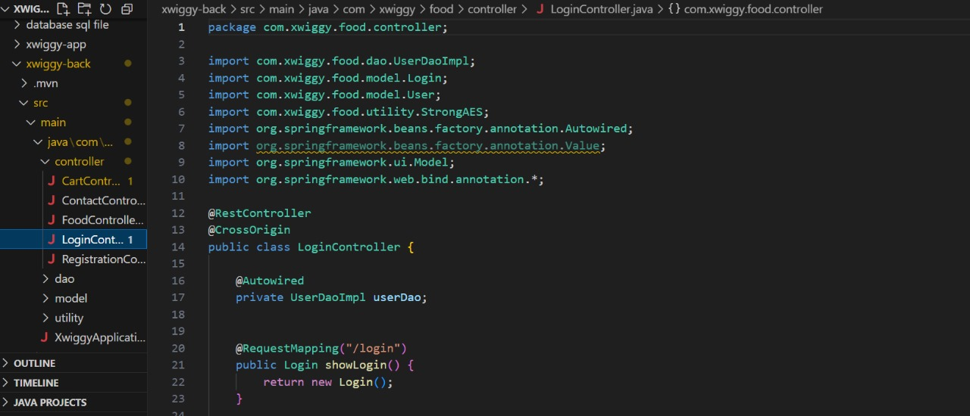
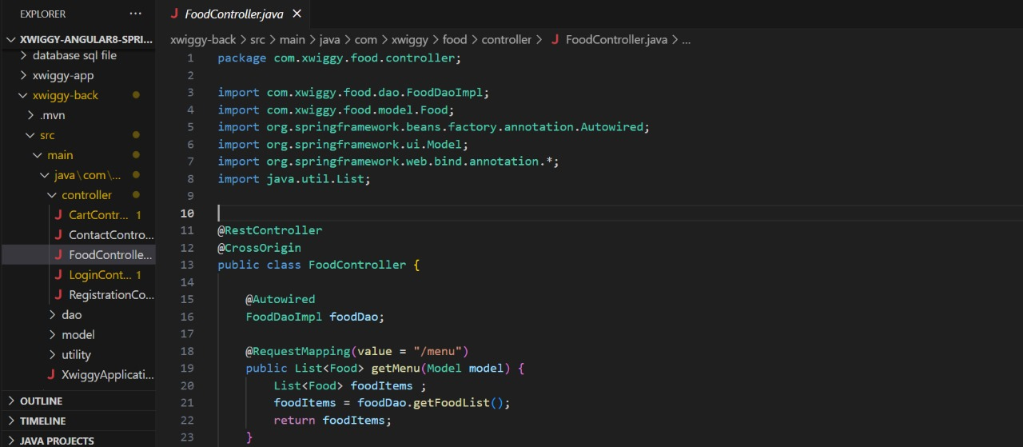
Implementation

Slide 14
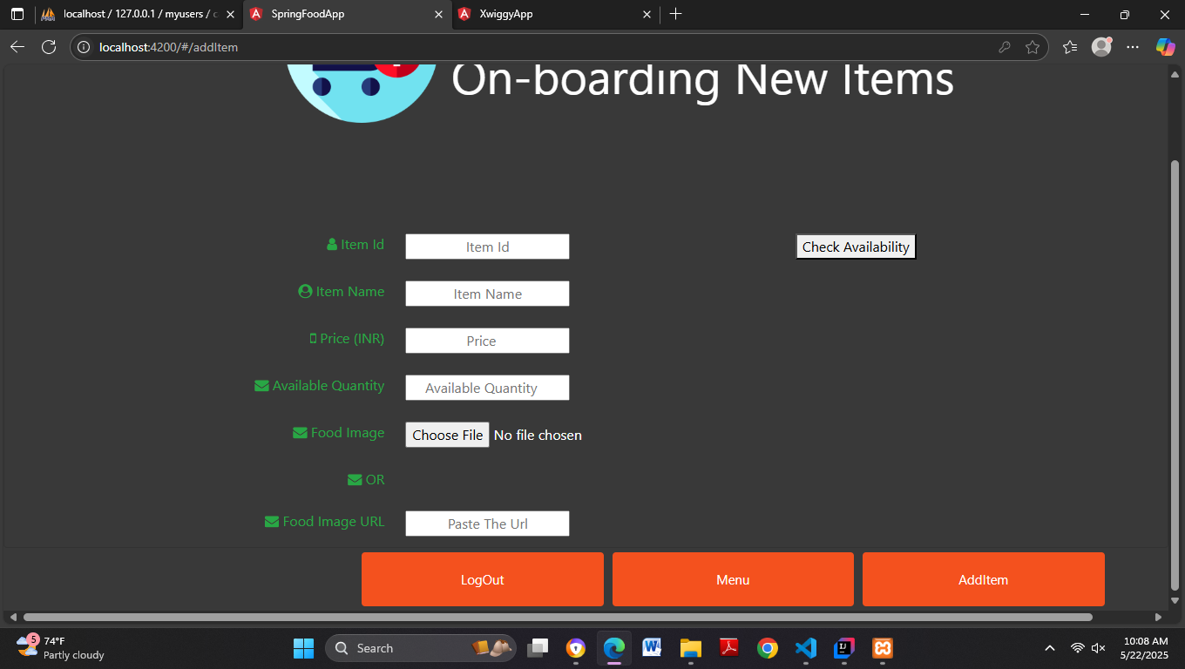
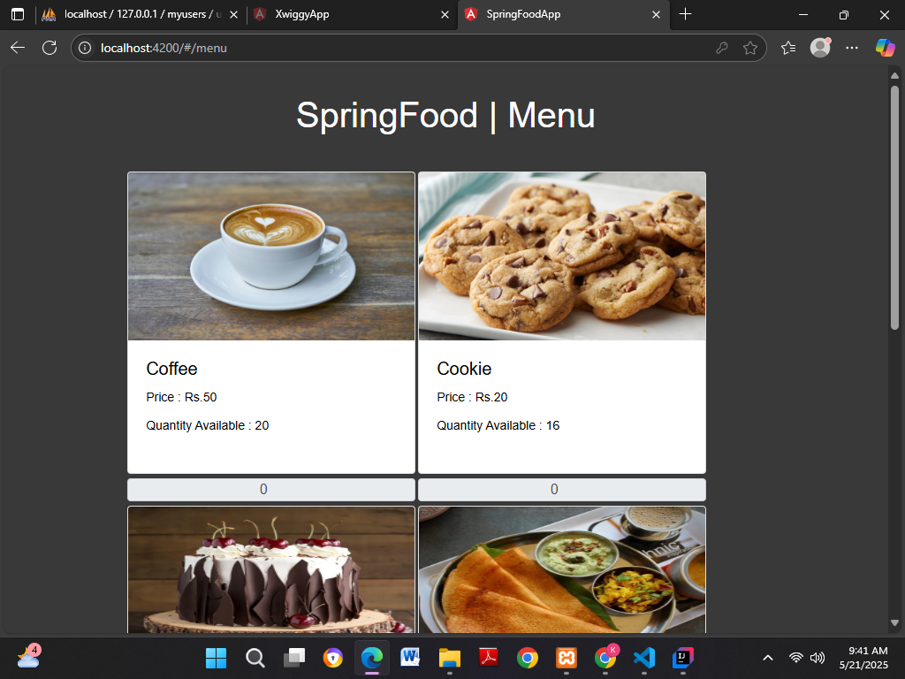
Result and Discussions

Slide 15
CONCLUSIONS
The Spring E-Commerce Website to Sell Food Items simplifies the online food ordering process and enhances user experience by automating tasks like browsing menus, placing orders, and managing inventories. It offers two interfaces: a merchant/admin panel to manage food items and view orders, and a customer portal for browsing menus and placing orders. A secure MySQL database stores all essential data, and the interface is user-friendly and responsive
This system applies core principles of software engineering, database management, and UI design to address real-world challenges in the food delivery domain. With potential for future upgrades like payment gateway integration, real-time delivery tracking, and AI-powered recommendations, it significantly boosts efficiency for food vendors while offering convenience to customers. The system's modular design ensures easy maintenance and scalability, allowing it to adapt to growing business needs. Its use of modern technologies like Angular, Spring Boot, MySQL, and JWT authentication supports a seamless and secure digital experience. Overall, it stands as a reliable solution for digitizing food commerce in the restaurant and retail sectors

Slide 16
Future Enhancements
Payment Gateway Integration:To provide a complete e-commerce experience, integrating a secure and reliable payment gateway such as Razorpay, PayPal, or Stripe will allow users to pay directly through the platform.
Real-Time order tracking :Implementing real-time tracking features will enhance user engagement and transparency. Customers will be able to monitor the status of their orders.
Mobile App Development: A mobile app version of the platform, developed using frameworks like React Native or Flutter, will expand accessibility. It will allow users to place orders on the go and receive instant notifications for promotions or order updates. .
AI-Powered Recommendations :ncorporating artificial intelligence can personalize the user experience by recommending food items based on browsing history, order frequency, and trending items

Slide 17
REFERENCES
[1] Gajera, J. (n.d.). E-commerce project using Spring Boot. GitHub. Retrieved from https://github.com/JayGajera/E-commerce-project-springBoot.
[2] M. Sharma and A. Gupta. 2022. Development of an Online Food Ordering System using Spring Boot and Angular. International Journal of Computer Applications, 184, 12 (2022), 22–28.
[3R. Mehta and S. Verma. 2021. Design and Implementation of E-commerce Web Application for Food Delivery. International Journal of Innovative Technology and Exploring Engineering, 10, 6 (2021), 63–67
[4] P. Patel and D. Shah. 2023. Full Stack Online Food Ordering System using Angular and Spring Boot. International Research Journal of Engineering and Technology (IRJET), 10, 3 (2023), 1231–1236.
[5] S. Roy and B. Sen. 2020. A Review on Food Delivery Systems and Their Development with Spring Boot Framework. International Journal of Scientific Research in Computer Science, 8, 5 (2020), 245–250

Slide 18
Question and Answer

Slide 19
THANK YOU

